Slide 1
Website “Learnidox”
Kairbek Almat, BDA-2106
https://github.com/impul4e/WebProjectFinal.git

Slide 2

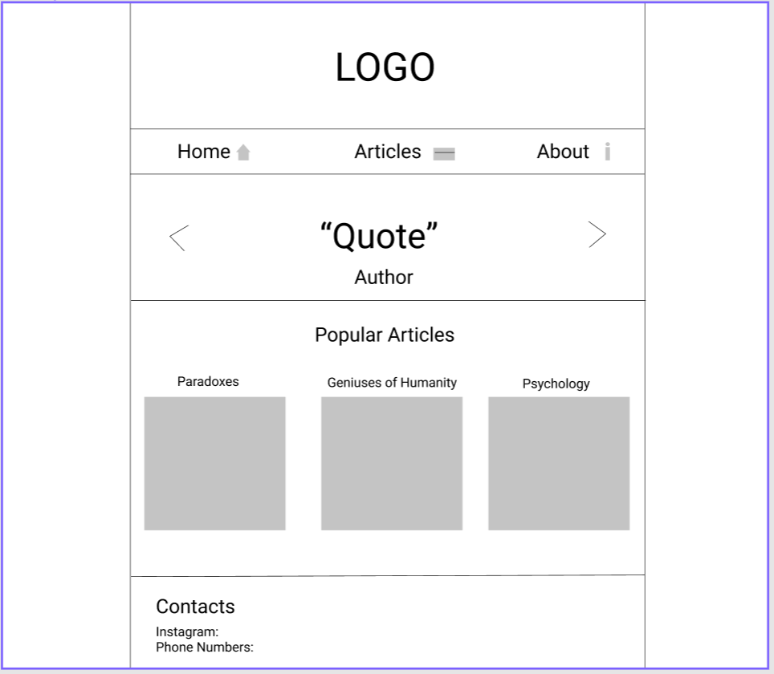
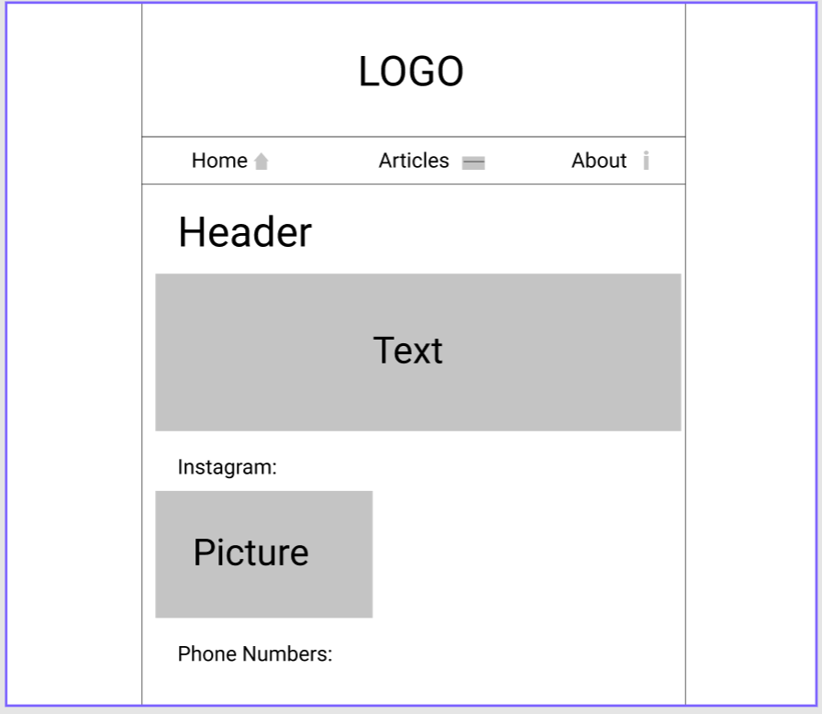
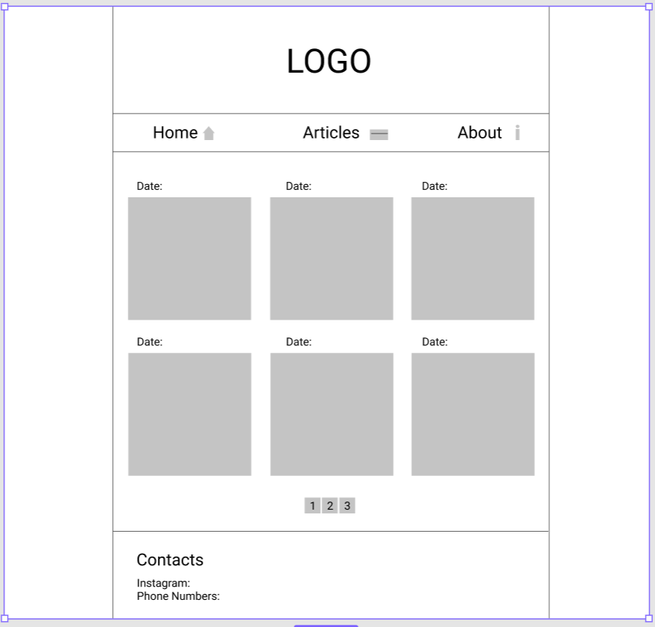
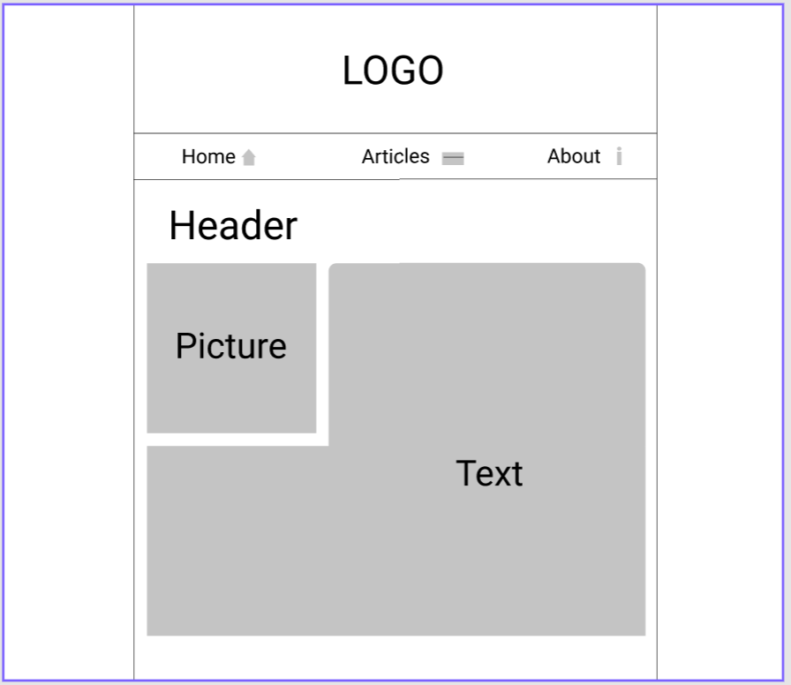
Wireframes
Examples of wireframes:
Main page
Page With Articles
Informational page about the website
Article page

Slide 3
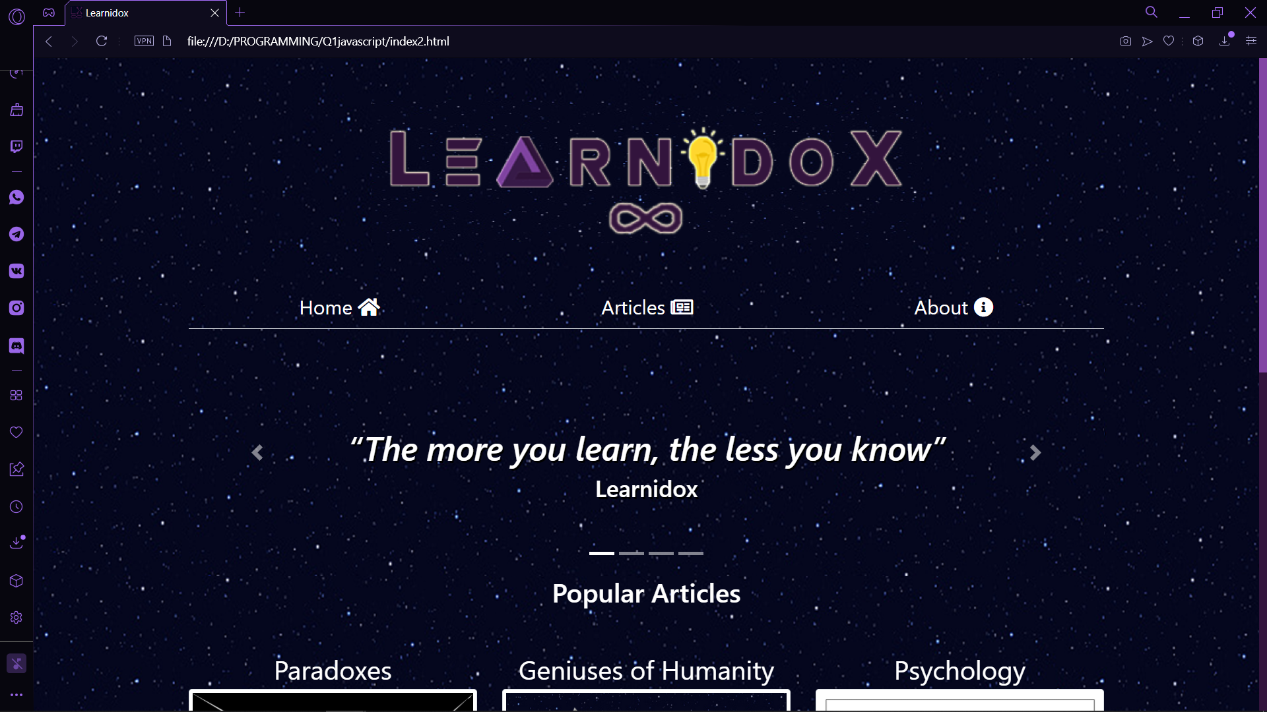
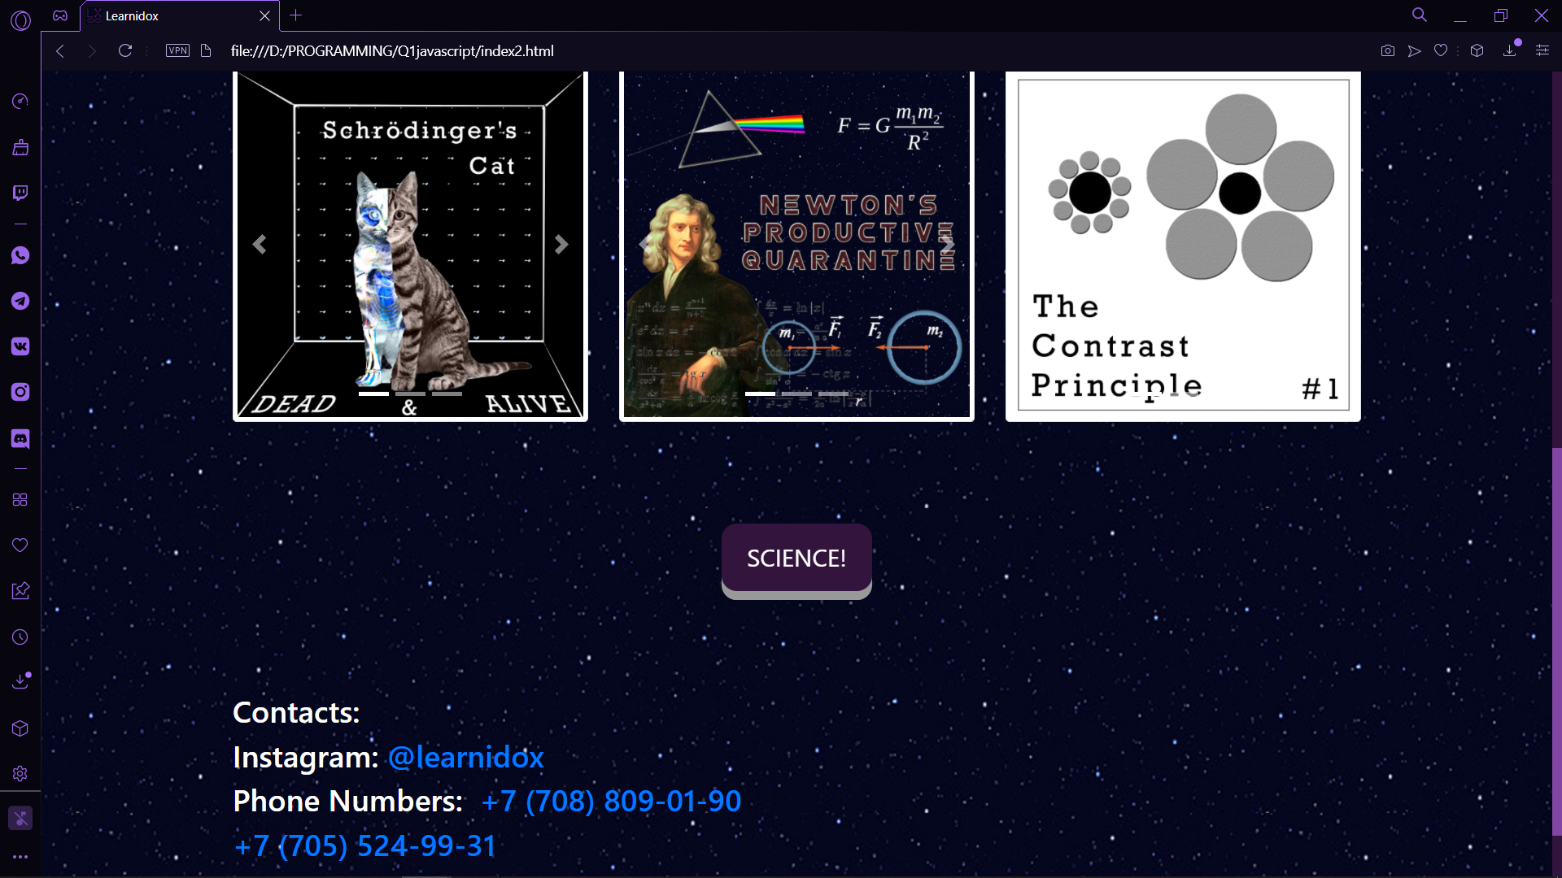
Home Page
Logo: when the user clicks on it, the webpage starts music: Stars - Skillet (JS)
Menu contains sections: “Home”, “Articles” and “About” (Bootstrap)
Carousel of quotes(Bootstrap)
Animation of Three Carousels of popular articles containing different types of content (Bootstrap)
“SCIENCE!” button: : when the user clicks on it, the webpage starts music: The Scientist - Coldplay (JS)
Contact information

Slide 4
<!DOCTYPE html> <html lang="en"> <head> <meta charset="UTF-8"> <title>Learnidox</title> <link rel="icon" type="image/x-icon" href="images/favicon.ico"> <link href="css/normalize.css" rel="stylesheet" type="text/css"> <link href="css/style.css" rel="stylesheet" type="text/css"> <link rel="stylesheet" href="https://maxcdn.bootstrapcdn.com/bootstrap/4.5.0/css/bootstrap.min.css"> <script src="https://ajax.googleapis.com/ajax/libs/jquery/3.5.1/jquery.min.js"></script> <script src="https://cdnjs.cloudflare.com/ajax/libs/popper.js/1.16.0/umd/popper.min.js"></script> <script src="https://maxcdn.bootstrapcdn.com/bootstrap/4.5.0/js/bootstrap.min.js"></script> <script src="https://kit.fontawesome.com/c242390850.js" crossorigin="anonymous"></script> <link href="https://unpkg.com/aos@2.3.1/dist/aos.css" rel="stylesheet"> </head> <body style="background-image: url(images/Space.png);"> <div class="container"> <!--Logo --> <div style="text-align: center; margin-bottom: 50px"> <img onclick="play()" src="images/LearnidoxLogo.png" alt="" class="" style="width: 60%; height: auto;margin-top: 50px; "> <audio id= "audio" src="Skillet - Stars (mp3store.cc).mp3"></audio> </div> <!--Menu --> <ul class="nav nav-tabs nav-st nav-fill"> <li class="nav-item"> <a class="nav-link" href="index2.html">Home <i class="fas fa-home"></i></a> </li> <li class="nav-item"> <a class="nav-link" href="articles.html">Articles <i class="far fa-newspaper"></i></a> </li> <li class="nav-item"> <a class="nav-link" href="about.html">About <i class="fas fa-info-circle"></i></a> </li> </ul>
<!--Carousel of Quotes --> <div id="carouselQuotes" class="carousel slide" data-ride="carousel"> <ol class="carousel-indicators"> <li data-target="#carouselQuotes" data-slide-to="0" class="active"></li> <li data-target="#carouselQuotes" data-slide-to="1"></li> <li data-target="#carouselQuotes" data-slide-to="2"></li> <li data-target="#carouselQuotes" data-slide-to="3"></li> </ol> <div class="carousel-inner" role="listbox" style="background-image: url(images/Space.png);"> <div class="carousel-item active"> <br><br><br><br><br> <h1 class="hg"><em><q>The more you learn, the less you know</q></em></h1> <h3 class="hg">Learnidox</h3> </div> <div class="carousel-item"> <br><br><br><br><br> <h1 class="hg"><em><q>Passion is the genesis of genius</q></em></h1> <h3 class="hg">Galileo Galilei</h3> </div> <div class="carousel-item"> <br><br><br><br><br> <h1 class="hg"><em><q>The important thing is never stop questioning</q></em></h1> <h3 class="hg">Albert Einstein</h3> </div> <div class="carousel-item"> <br><br><br><br><br> <h1 class="hg"><em><q>Science is nothing but perception</q></em></h1> <h3 class="hg">Plato</h3> </div> </div> <a class="carousel-control-prev" href="#carouselQuotes" role="button" data-slide="prev"> <span class="carousel-control-prev-icon" aria-hidden="true"></span> <span class="sr-only">Previous</span> </a> <a class="carousel-control-next" href="#carouselQuotes" role="button" data-slide="next"> <span class="carousel-control-next-icon" aria-hidden="true"></span> <span class="sr-only">Next</span> </a> </div>

Slide 5
<!--Carousel of Popular Articles--> <div data-aos="fade-up" data-aos-duration="2000" class="containerA" id="articles"> <h1 class="panel-heading" style="margin-bottom: 50px;">Popular Articles</h1> <div class="row"> <div class="col-sm-4"> <div class="panel-heading">Paradoxes</div> <div class="img-px" style="display: block;"> <div id="myCarouselPx" class="carousel slide" data-ride="carousel"> <!-- Indicators --> <ol class="carousel-indicators"> <li data-target="#myCarouselPx" data-slide-to="0" class="active"></li> <li data-target="#myCarouselPx" data-slide-to="1"></li> <li data-target="#myCarouselPx" data-slide-to="2"></li> </ol> <!-- Wrapper for slides --> <div class="carousel-inner" style="background-image: url(images/Space.png);"> <div class="carousel-item active img-px" > <a href="articles/Cat.html" target="_blank"> <img class= "img-fluid img-thumbnail" src="images/paradoxes/Cat.png" alt=""> </a> </div> <div class="carousel-item img-px"> <a href="articles/theseus.html" target="_blank"> <img class= "img-fluid img-thumbnail" src="images/paradoxes/Theseus.png" alt=""> </a> </div> <div class="carousel-item img-px"> <a href="articles/grandfather.html" target="_blank"> <img class= "img-fluid img-thumbnail" src="images/paradoxes/Grandfather Paradox2.png" alt=""> </a> </div> </div> <!-- Left and right controls --> <a class="carousel-control-prev" href="#myCarouselPx" role="button" data-slide="prev"> <span class="carousel-control-prev-icon" aria-hidden="true"></span> <span class="sr-only">Previous</span> </a> <a class="carousel-control-next" href="#myCarouselPx" role="button" data-slide="next"> <span class="carousel-control-next-icon" aria-hidden="true"></span> <span class="sr-only">Next</span> </a> </div> </div> </div>
<!--Contact Information--> <div class="containerContacts" id="contacts"> <h3 style="font-size:2vw;">Contacts:</h3> <h5 style="font-size:2vw;">Instagram: <a href="https://www.instagram.com/learnidox/" target="_blank">@learnidox</a></h5> <h5 style="font-size:2vw;">Phone Numbers:<a href="tel: +7 (708) 809-01-90 " >&nbsp; +7 (708) 809-01-90</a></h5> <h5 style="font-size:2vw;"><a href="tel: +7 (705) 524-99-31"> +7 (705) 524-99-31</a></h5> </div> <audio src="Skillet - Watching for comets.mp3" id="my_audio" loop="loop"></audio> </div> <script src="https://unpkg.com/aos@2.3.1/dist/aos.js"></script> <script type="text/javascript"> window.onload=function(){ document.getElementById("my_audio").play(); } function play() { let x = document.getElementById("audio"); x.volume = 0.05; x.play(); } </script> <script>AOS.init();</script> <script> let scroll = new SmoothScroll('a[href*="#"]'); </script> </body> </html>

Slide 6
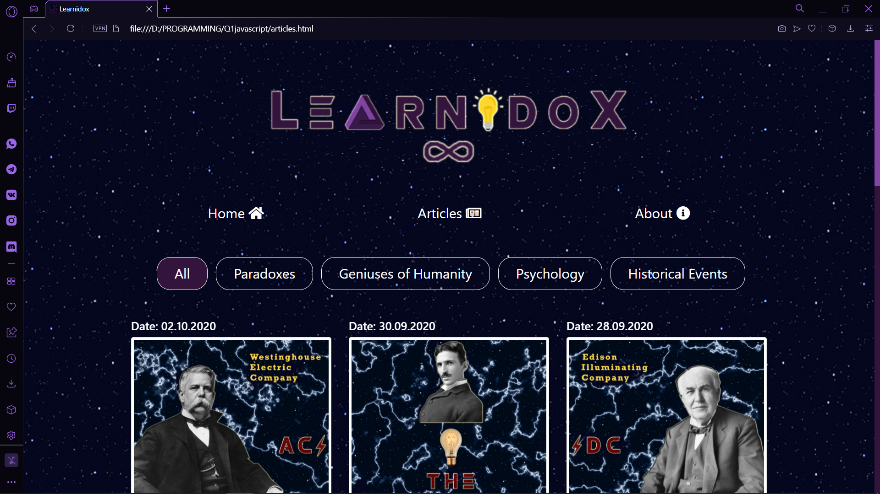
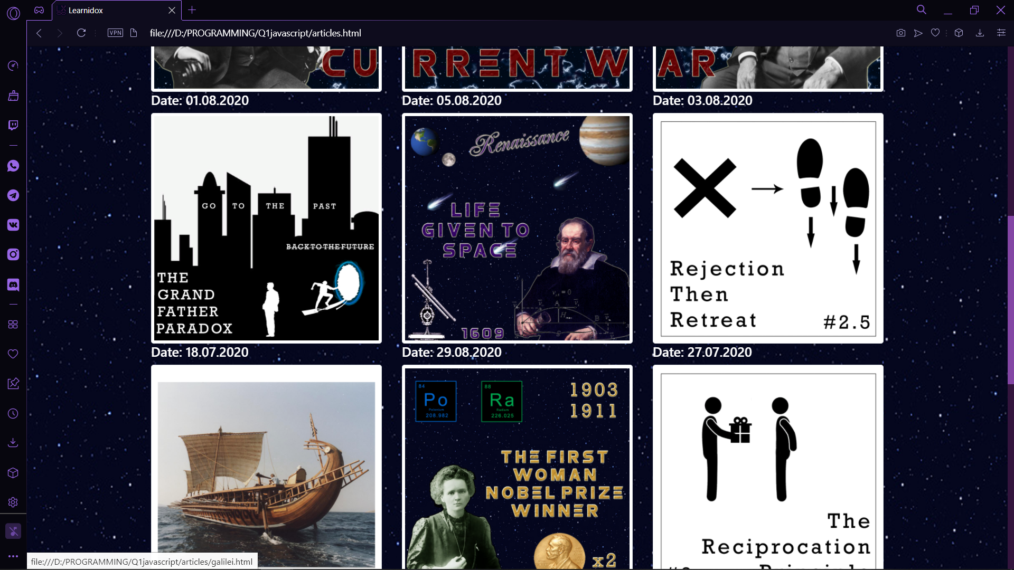
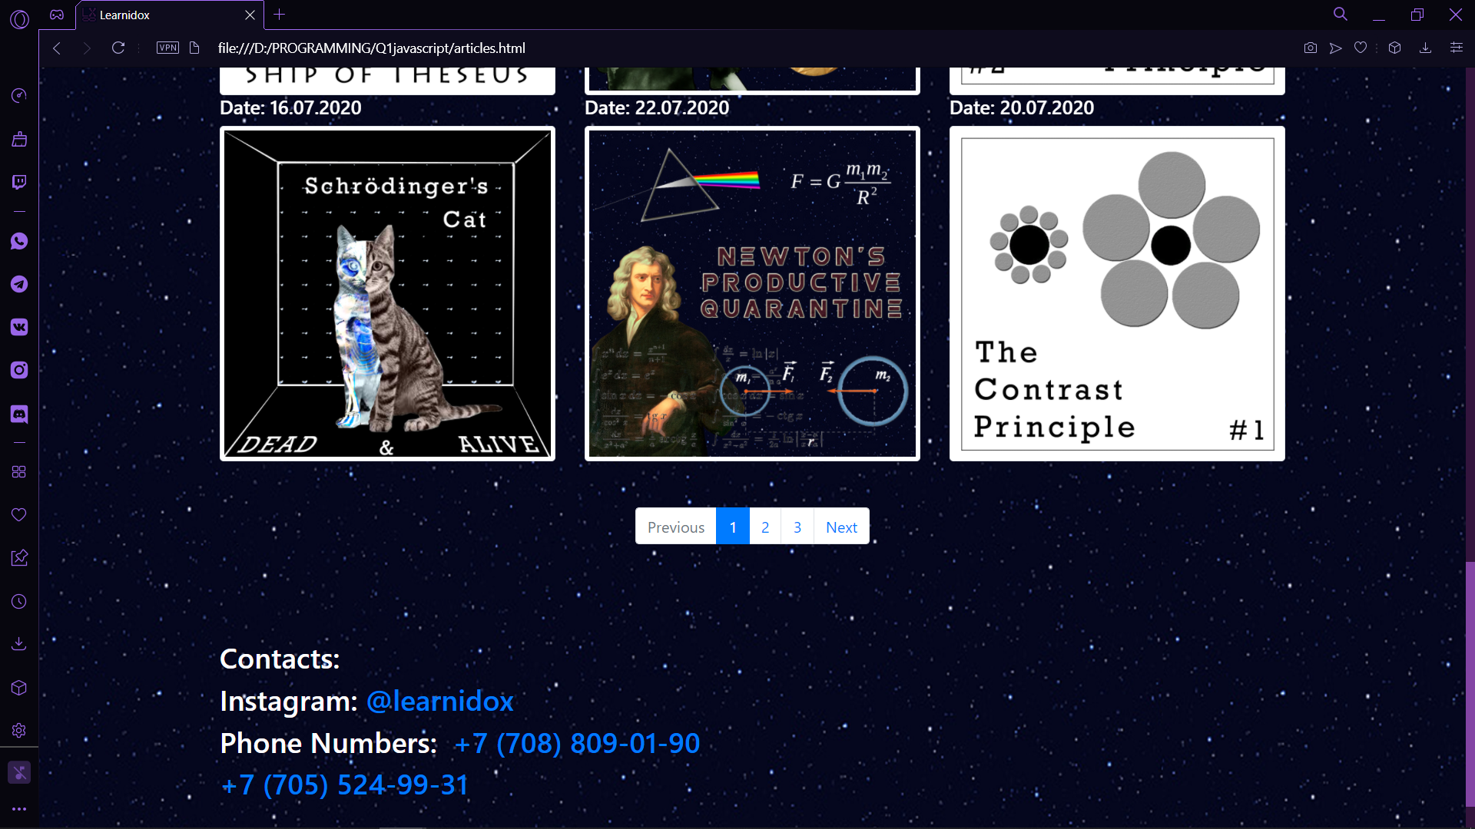
Page of Articles
Logo: when the user clicks on it, the webpage starts music: Watching the comets - Skillet (JS)
Menu contains sections: “Home”, “Articles” and “About” (Bootstrap)
Article topics: “Paradox”, “Geniuses of humanity”, “Psychology”, “Historical Events” (JS: mouseover)
Articles’ previews: divided into 3 columns
Pagination (Bootstrap)
Contact information

Slide 7
<nav aria-label="..."> <ul class="pagination justify-content-center"> <li class="page-item disabled"> <a class="page-link" href="" tabindex="-1" aria-disabled="true">Previous</a> </li> <li class="page-item active" aria-current="page"><a class="page-link" href="articles.html">1</a></li> <li class="page-item"> <a class="page-link" href="articles2.html">2 <span class="sr-only"></span></a> </li> <li class="page-item"><a class="page-link" href="articles3.html">3</a></li> <li class="page-item"> <a class="page-link" href="articles2.html">Next</a> </li> </ul> </nav>
<!--Articles' Block--> <div class="containerA-menu"> <ul > <li class="active " id = "menu" onmouseover="mouseOver()" onmouseout="mouseOut()" data-filter="*">All</li> <li class="paradox" id = "menu2" onmouseover="mouseOver2()" onmouseout="mouseOut2()" data-filter=".paradox">Paradoxes</li> <li class="genius" id = "menu3" onmouseover="mouseOver3()" onmouseout="mouseOut3()" data-filter=".genius">Geniuses of Humanity</li> <li class="psychology" id = "menu4" onmouseover="mouseOver4()" onmouseout="mouseOut4()" data-filter=".psychology">Psychology</li> <li class="he" id = "menu5" onmouseover="mouseOver5()" onmouseout="mouseOut5()" data-filter=".he">Historical Events</li> </ul> </div> <div data-aos="fade-up" data-aos-duration="2000" class="row containerA-item"> <div data-aos="fade-up" data-aos-duration="2000" class="item he col-sm-4"> <h5>Date: 02.10.2020</h5> <a href="articles/cw1.html" target="_blank"> <img class= "img-fluid img-thumbnail" src="images/CW1.png" alt=""> </a> </div> <div data-aos="fade-up" data-aos-duration="2000" class="item he col-sm-4"> <h5>Date: 30.09.2020</h5> <a href="articles/cw2.html" target="_blank"> <img class= "img-fluid img-thumbnail" src="images/CW2.png" alt=""> </a> </div> <div data-aos="fade-up" data-aos-duration="2000" class="item he col-sm-4"> <h5>Date: 28.09.2020</h5> <a href="articles/cw3.html" target="_blank"> <img class= "img-fluid img-thumbnail" src="images/CW3.png" alt=""> </a> </div>
<!-- Taking specific topics--> <script src="js/jquery.min.js"></script> <script src="js/isotope.pkgd.min.js"></script> <script> $('.containerA-menu ul li').click(function() { $('.containerA-menu ul li').removeClass('active'); $(this).addClass('active'); var selector=$(this).attr('data-filter'); $('.containerA-item').isotope({ filter:selector }); return false; }); </script> <script> function mouseOver() { document.getElementById("menu").style.color = "#8345a4"; }

Slide 8
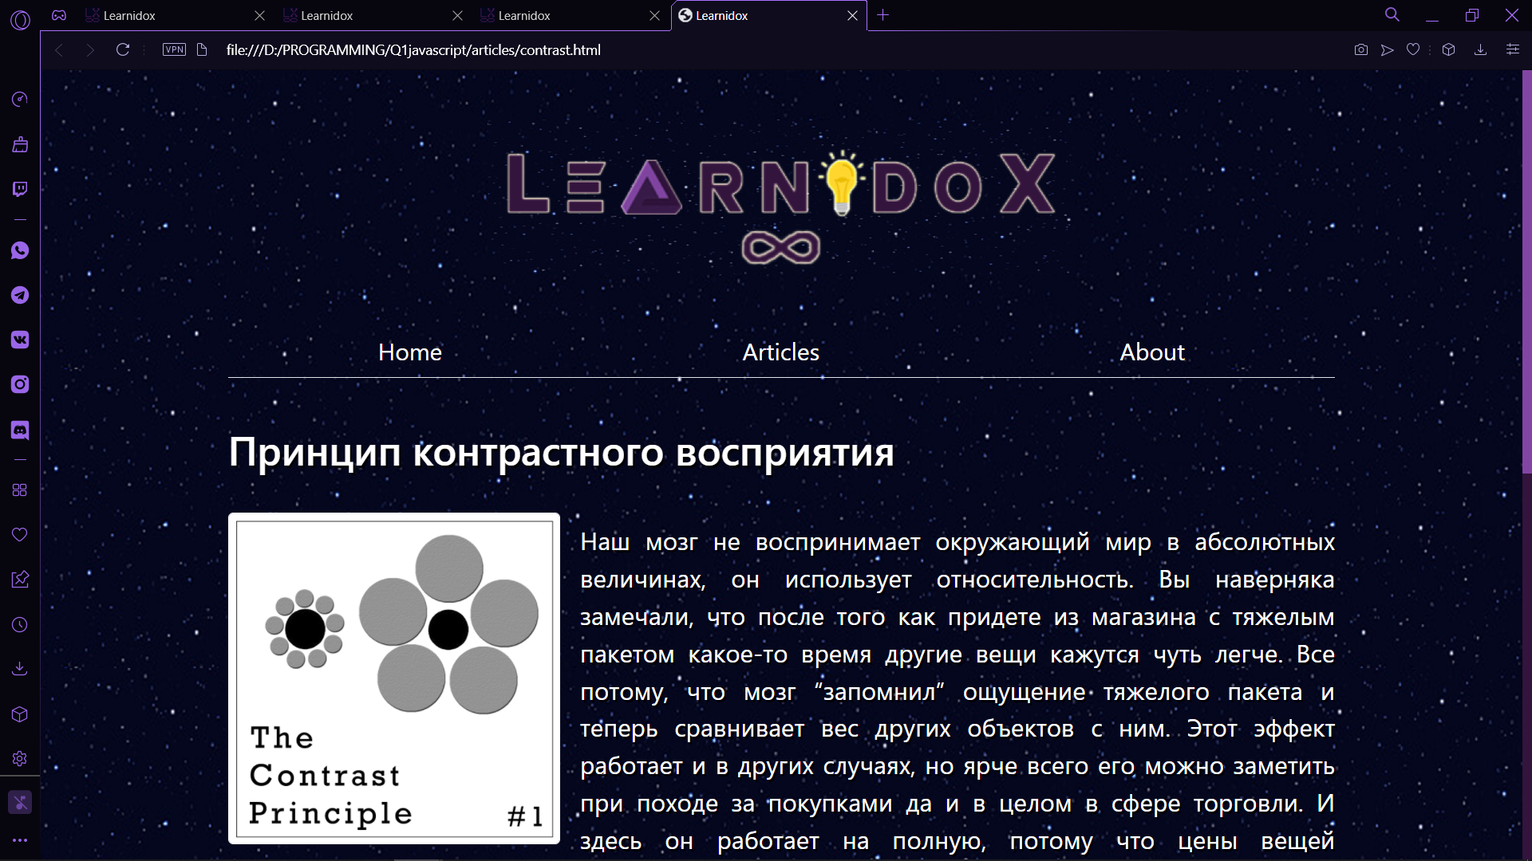
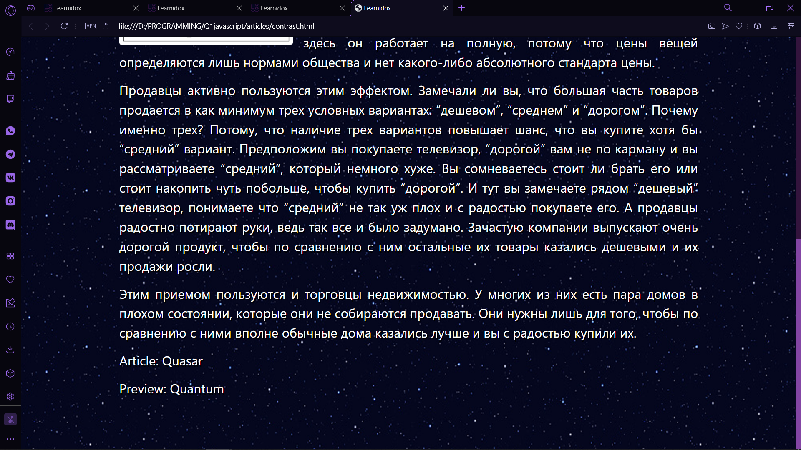
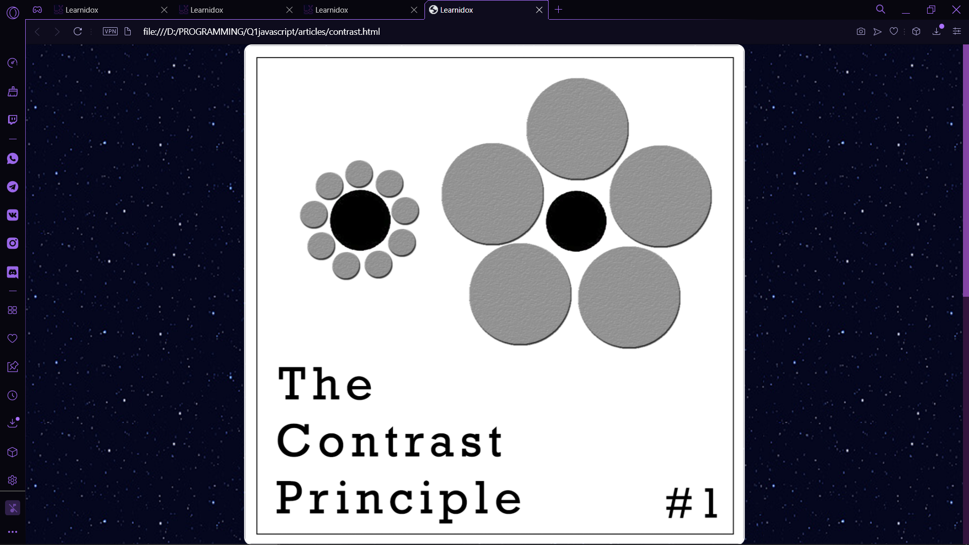
Article page
Logo
Menu contains sections: “Home”, “Articles” and “About” (Bootstrap)
Article contains: Preview and Context
Preview can be enlarged (JS)

Slide 9
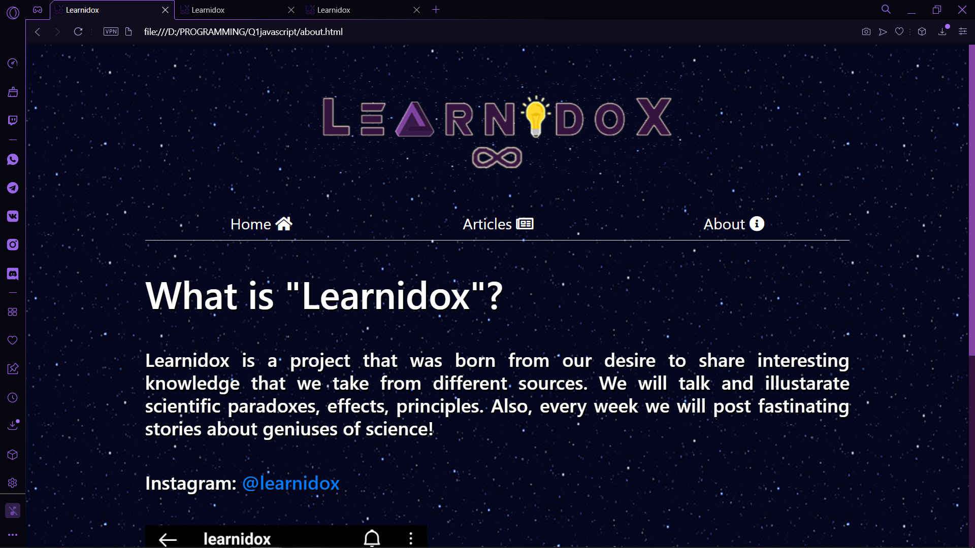
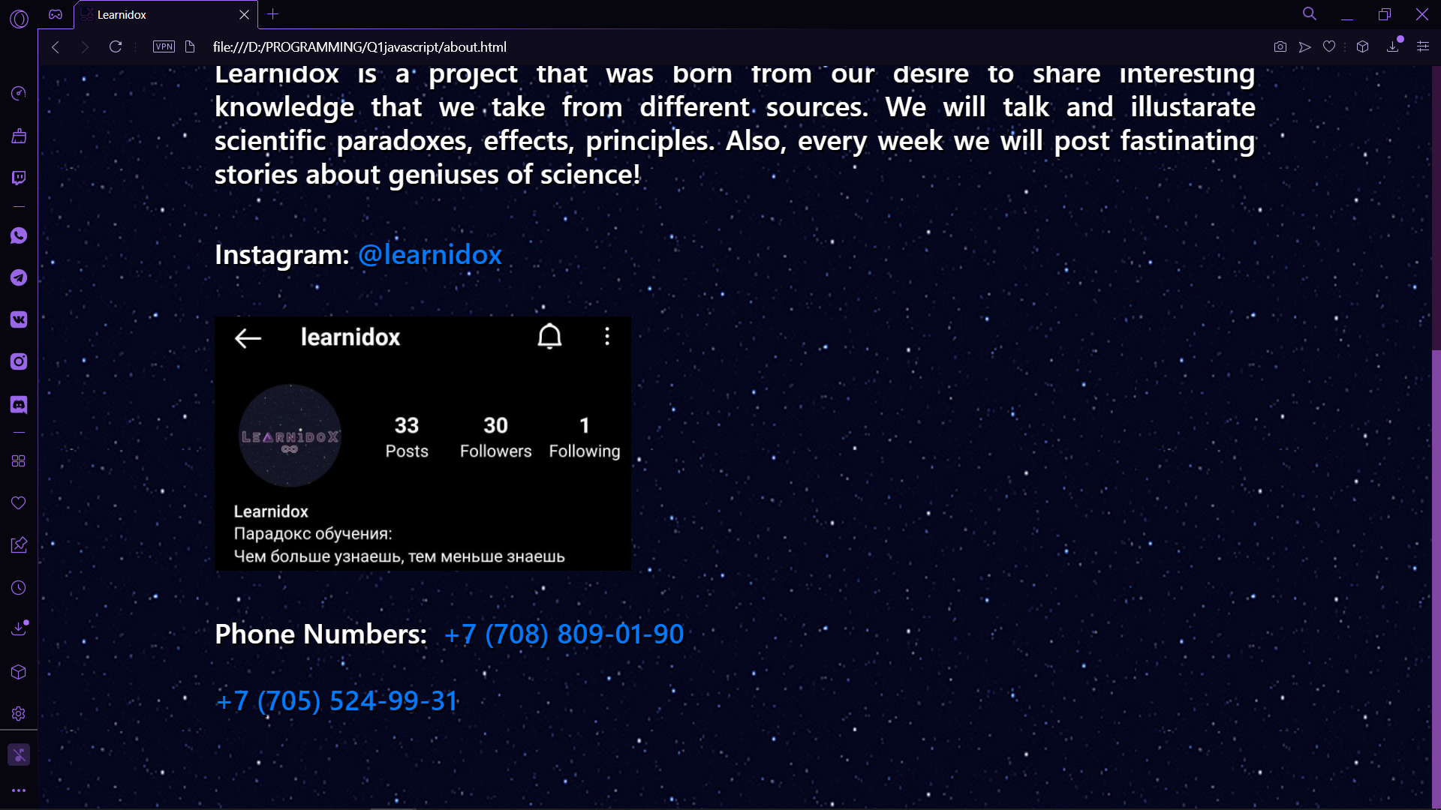
Page “About”
Logo
Menu contains sections: “Home”, “Articles” and “About” (Bootstrap)
Information about “Learnidox”
Contact information

Slide 10
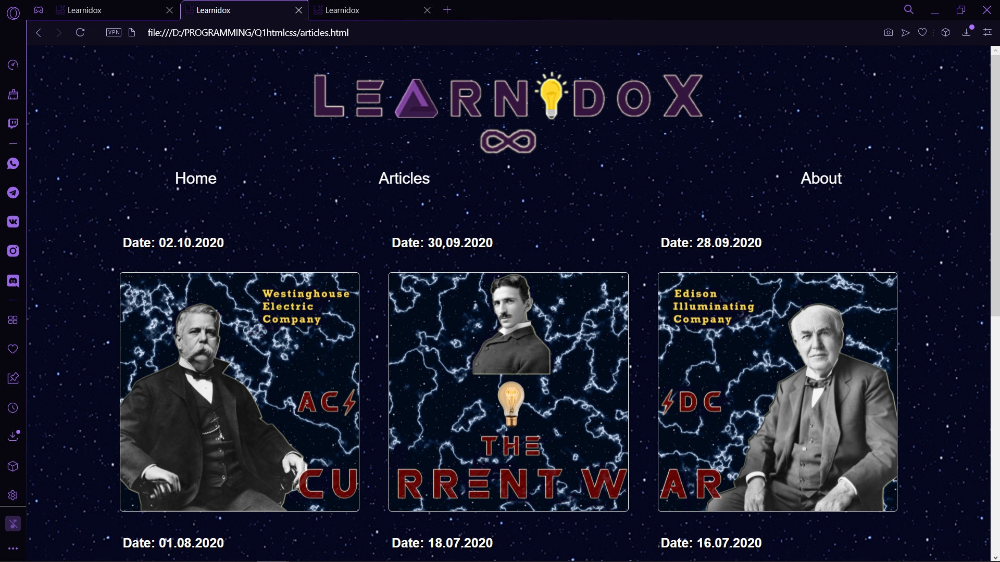
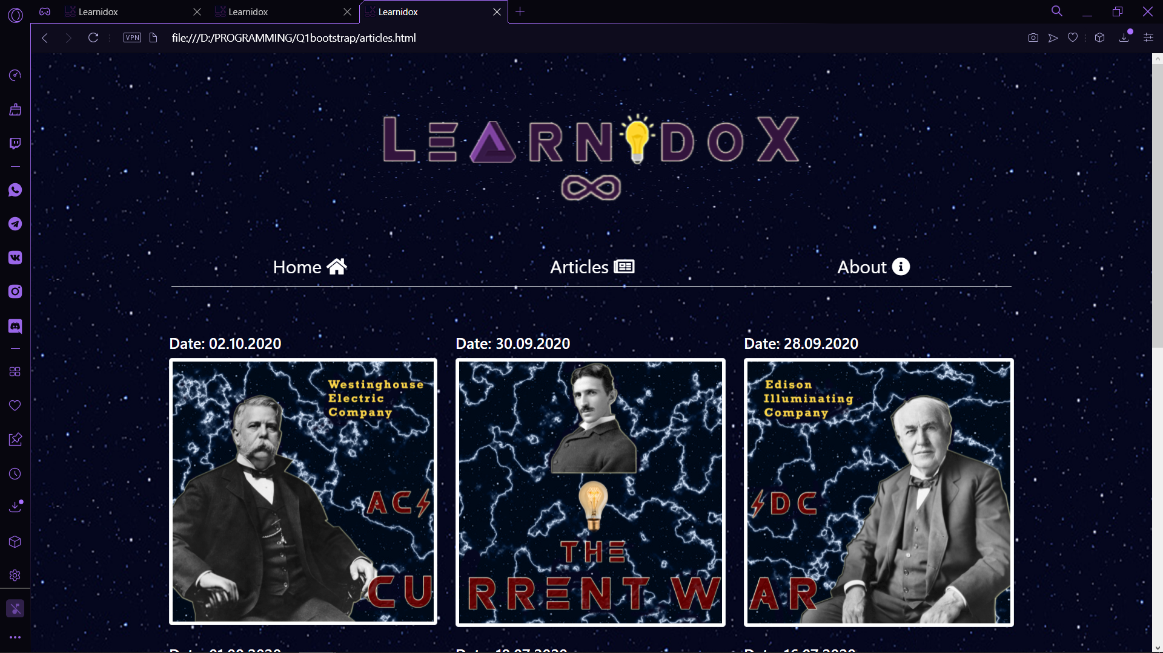
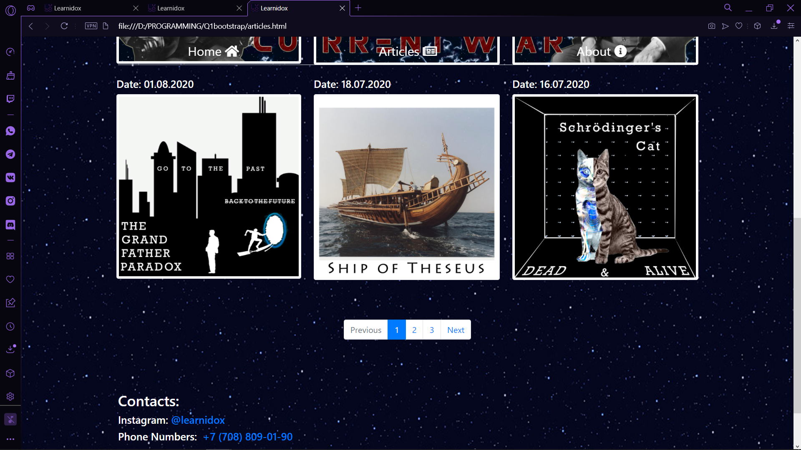
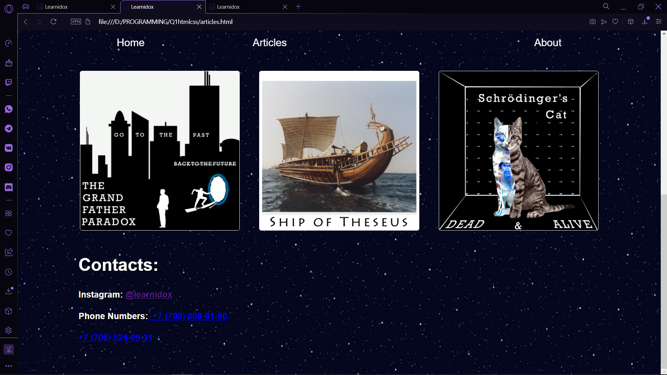
HTML/CSS
Bootstrap
Javascript

Slide 11
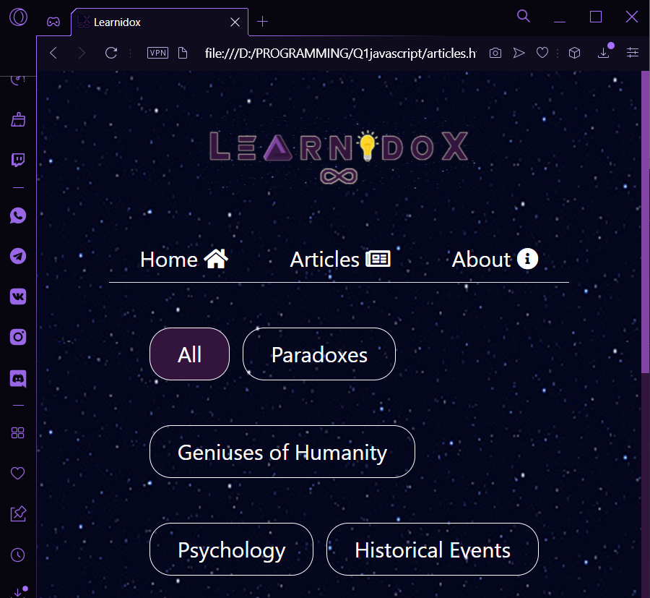
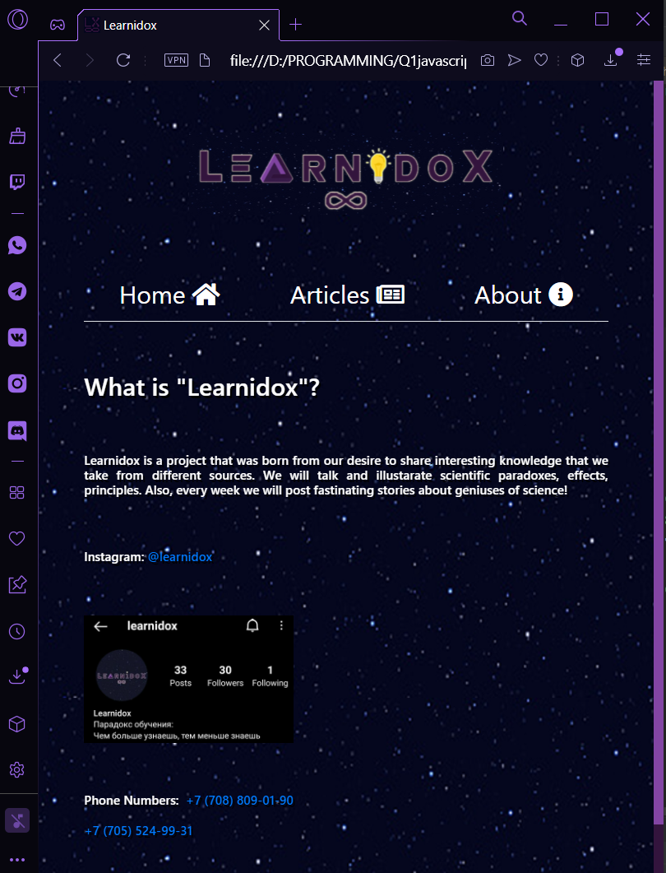
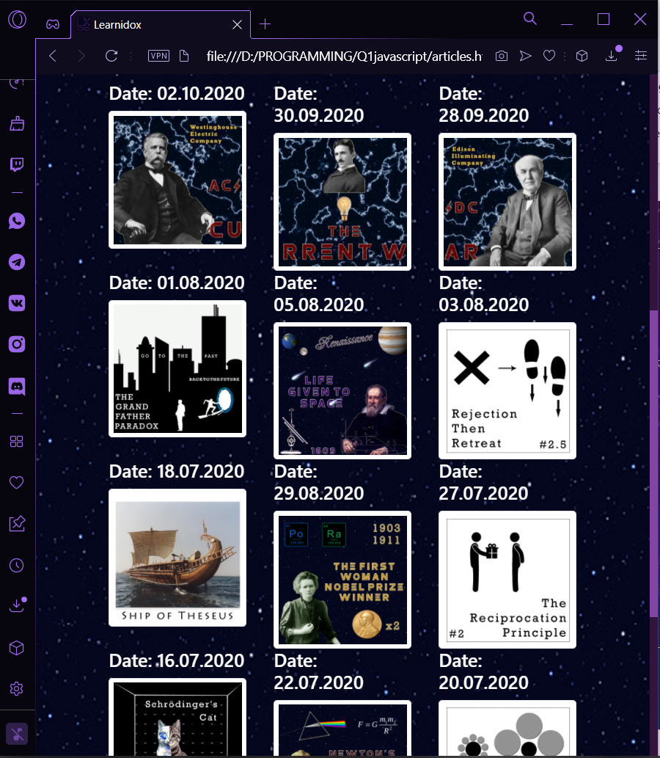
website RESponsiveness

Slide 12

Result
Website “Learnidox” was developed step by step from just using html/css to including bootstrap and Javascript.
Further development can be done by adding back-end.

Slide 13
<h1 style=“color: white”>Thank you for your attention<h1>

